Slide 1

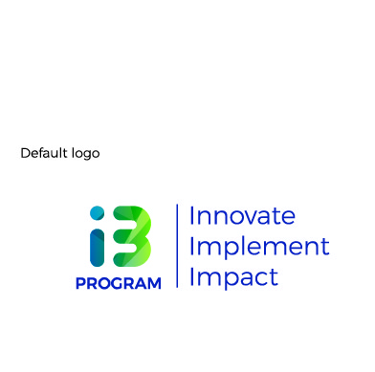

Introduction to HCD

Slide 2
HCD is redefining development by meeting people where they are and really taking their needs into account. When you let people participate in the design process, you often find that they have ingenious ideas about what would really help them.
- Melinda Gates, Co Founder – Bill & Melinda Gates Foundation

Slide 3
HUMAN CENTERED DESIGN (HCD) IS A CREATIVE AND LOGICAL METHOD FOR SOLVING COMPLEX PROBLEMS.
IT LEARNS AND BORROWS FROM MULTIPLE PROBLEM SOLVING METHODS AND BRINGS THEM TOGETHER UNDER ONE UMBRELLA.

Slide 4
HUMAN CENTERED DESIGN (HCD) IS ALSO COMMONLY KNOWN AS DESIGN THINKING.
THE TERMS HAVE FOUND MAINSTREAM ADOPTION IN THE PAST 20 YEARS - A SPURT IN INNOVATION, COMPLEXITY, EMERGING MARKETS, TECHNOLOGY, INTERCONNECTED SYSTEMS ETC.

Slide 5

REDESIGNING THE SHOPPING CART
In 1999, a show on the American ABC network filmed an episode focused on the design process with the Silicon Valley based firm IDEO. It was one of the first commentaries on the what would in years since then come to be known as Design Thinking. Episode Online (Link)

Slide 6
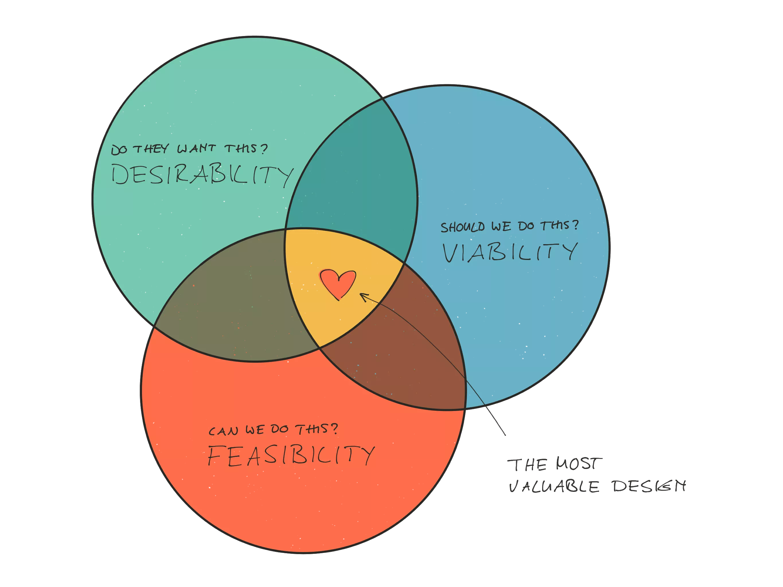
‘PEOPLE CENTRIC’ + ‘SYSTEMS VIEW’.
THE ROOTEDNESS IN PEOPLE, AND A SYSTEMS THINKING LENS DIFFERENTIATE THE METHOD.

Slide 7
THE 5 STAGES
HCD in its most basic framing is understood to have five core phases
FOUNDATION
DISCOVERY
DEFINE
IDEATION
PROTOTYPING
Build initial understanding of a problem or opportunity and the people who are impacted by or influence it
Study a problem or opportunity through the lenses of need, behaviour, motivation, pain and system dynamics - through interactions with people and other entities
Make sense of research and recognise actionable patterns, learnings, and insights to tackle problem or opportunity
Generate multiple creative ideas to solve for problem or opportunity - based on insights and understanding of users
Build and test experienceable early versions of the solution with target users
Notes:
that move from scoping of a problem or opportunity, deep contextual understanding of people’s lives and ecosystems, synthesis of insights, generation of ideas, and finally the creation and testing of concepts with target audiences.

Slide 8
FOUNDATION
DISCOVERY
DEFINE
IDEATION
PROTOTYPING
Typical Output
Scoping of opportunity or problem
Mapping of users and stakeholders
Project planning and visioning
Typical Output
Research plans and decision on tools to use
Data from on field and secondary research
Preliminary learnings and insights
Typical Output
Insights and key solution principles
Typical Output
Challenge statements and solution goals
Ideas
Early concepts
Typical Output
Refined concepts
Experienceable prototypes
Learnings and insights from user testing

Slide 9
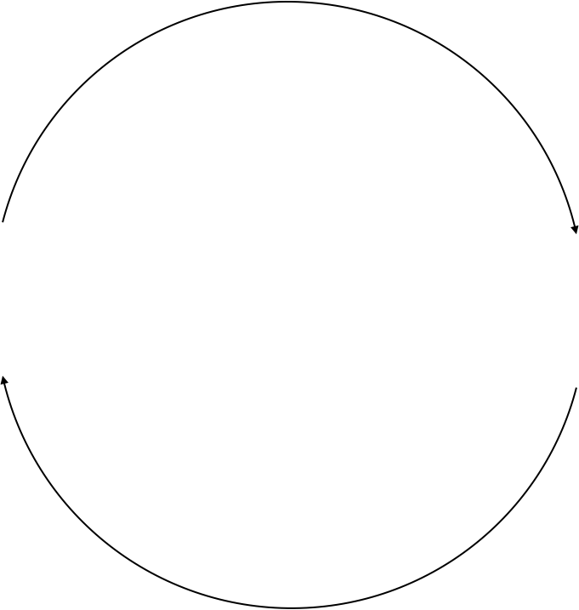
FOUNDATION
DISCOVERY
DEFINE
IDEATION
PROTOTYPING
ITERATE. ITERATE. ITERATE.

Slide 10
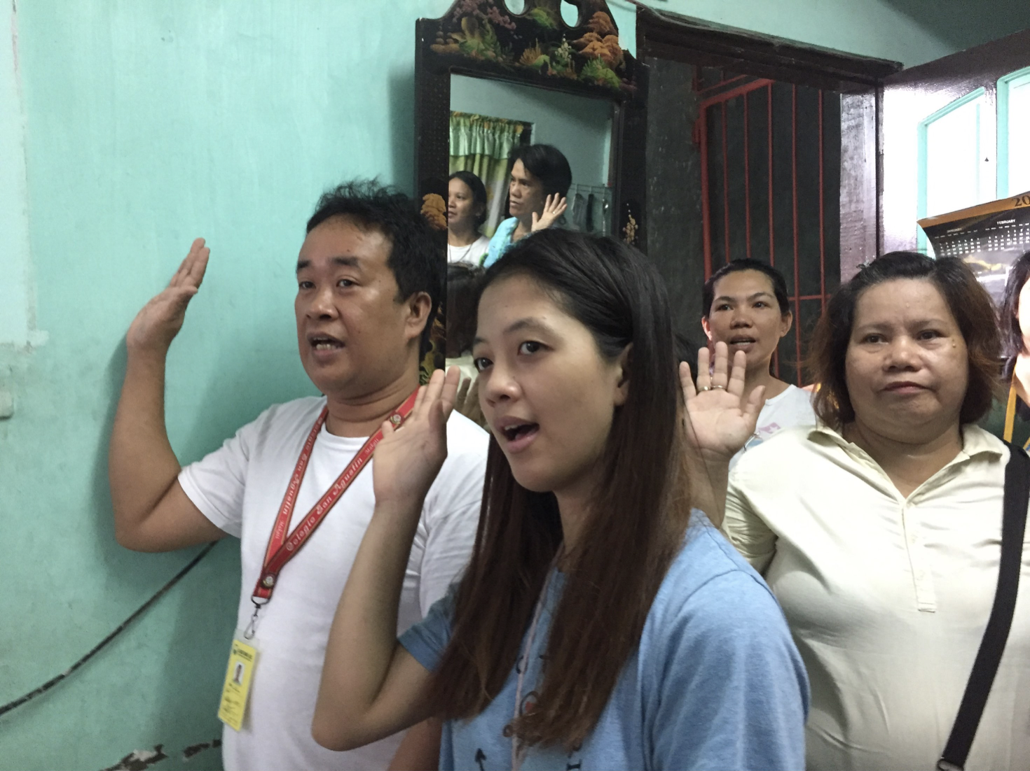
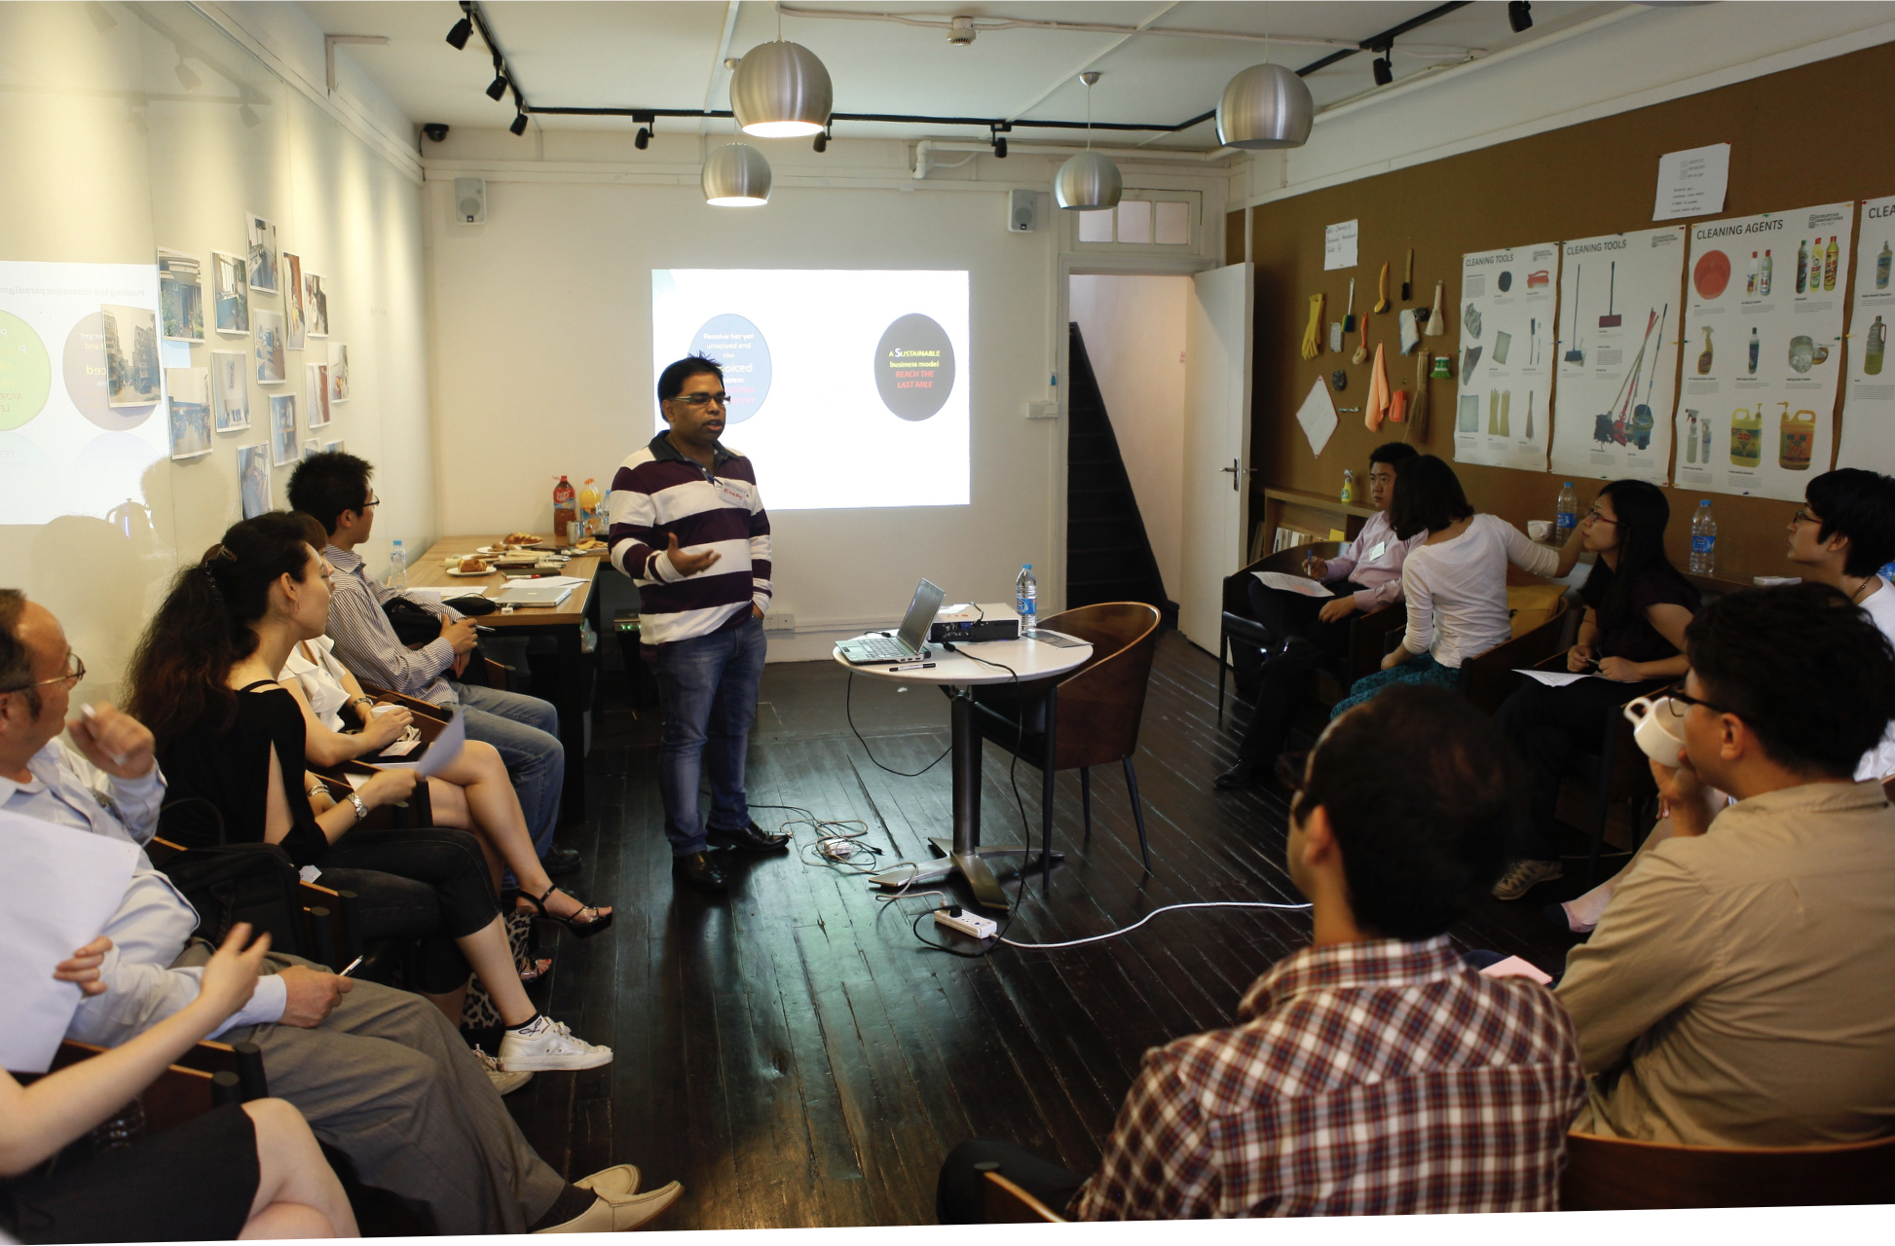
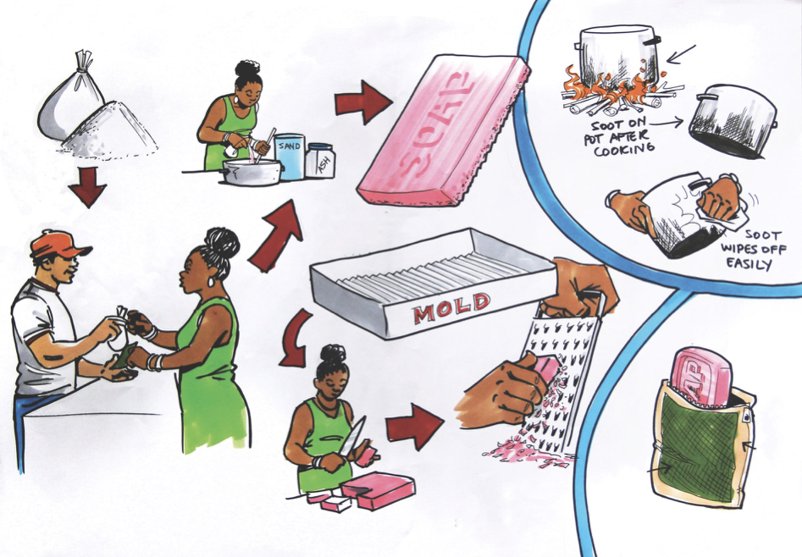
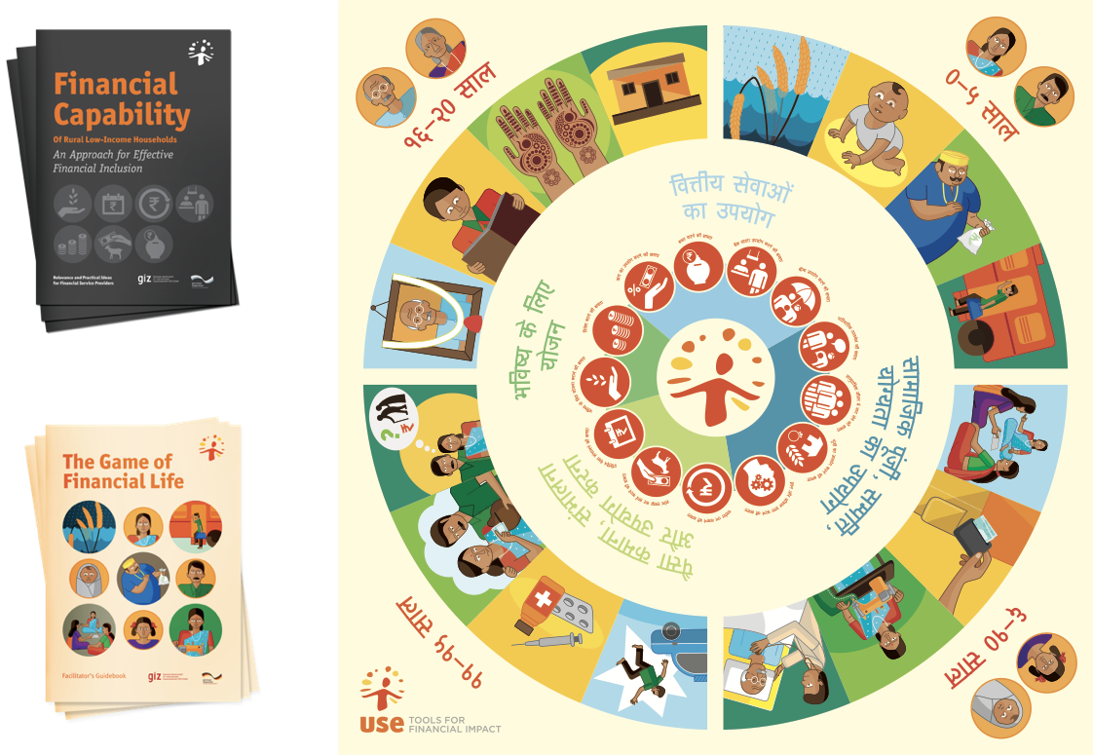
www.quicksand.co.in

Slide 11
KINDS OF HCD PROJECTS
FOUNDATION
DISCOVERY
DEFINE
IDEATION
PROTOTYPING
EXPLORATORY OR FOUNDATIONAL RESEARCH PROJECTS
CONCEPT GENERATION PROJECTS
USER CENTERED SOLUTION DEVELOPMENT PROJECTS

Slide 12
THE SPIRIT OF DESIGN THINKERS CAN BE SUMMARISED IN A FEW KEY QUALITIES.

Slide 13
KEY QUALITIES OF DESIGN THINKERS | ONE
EMPATHY
The quality of understanding someone’s joy, pain and anxieties without judging them. The commitment to making time and effort understand someone’s context first hand.

Slide 14
KEY QUALITIES OF DESIGN THINKERS | TWO
SYSTEMS THINKING
The quality of breaking down different aspects of a problem or opportunity, and being able to see relationships and dependencies.

Slide 15
KEY QUALITIES OF DESIGN THINKERS | THREE
MAKING
The quality of converting thoughts into ideas, ideas into blueprints, and blueprints into concrete plans and real world objects and experiences.

Slide 16
KEY QUALITIES OF DESIGN THINKERS | FOUR
EXPERIENCE CENTERED
The quality of breaking down different aspects of a problem or opportunity, and being able to see relationships and dependencies.

Slide 17
KEY QUALITIES OF DESIGN THINKERS | FIVE
PARTICIPATORY
The quality of including diverse opinions and skills in the process of identifying, building and assessing solutions.

Slide 18
KEY QUALITIES OF DESIGN THINKERS | SIX
ITERATIVE
The quality of constantly improving solutions based on learning and insight accumulated at each stage. To embrace the spirit of experimentation and exploration.

Slide 19
STARTUPS OFTEN FOLLOW DESIGN LED PRACTICES BY DEFAULT.
THE REAL CHALLENGE IS SYSTEMISING AND SUSTAINING DESIGN LED PRACTICES AS TIME PASSES AND AS A SENSE OF NORMALCY SETS IN.

Slide 20
?
Business as Norm Organisations
Design Led organisations
Create solutions driven by feasibility and viability constraints. Desirability and user needs are looked through constraints.
First address the desirability and needs challenge. Feasibility and viability work to meet the goals set.

Slide 21
?
Business as Norm Organisations
Design Led organisations
Follow a solution development approach along a linear path with the aim of arriving at one perfect end solution.
Follow an agile, iterative path with multiple imperfect solutions rapidly informing a solution that addresses real needs.

Slide 22
?
Business as Norm Organisations
Design Led organisations
Have different teams and experts typically handling research, strategy, solutions, build, launch, and scale - in silos.
Driven by inter-disciplinary, cross functional teams who own each step of the journey - together.

Slide 23
?
Business as Norm Organisations
Design Led organisations
Driven by a view of design that is limited to front-end aesthetics with no operational and systemic significance.
Understand and adopt design as fundamental organisational capability - front or back end.

Slide 24
?
Business as Norm Organisations
Design Led organisations
Satisfied with predictable success and the extension of proven formulas. The appetite for experimentation and risk is limited.
Embrace experimentation and exploration, and work out formula to make experimentation and risk taking sustainable.

Slide 25
FINANCIAL INCLUSION PROJECTS CAN BENEFIT FROM HCD.
HCD HAS BEEN AN INFLUENTIAL VOICE IN THE DISCOURSE ON FINANCIAL INCLUSION. FINANCIAL INCLUSION FACES THE CHALLENGE OF DESIGNING FOR PEOPLE’S NEEDS, BEHAVIOURS, SOCIAL, POLITICAL, AND TECHNOLOGICAL REALITIES.

